Slide 1
Restrictive Cardiomyopathy versus Constrictive Pericarditis: Challenges of CMR diagnosis
Ismahen Ben Yaacoub-Kzadri, sana Harguem, Rym Bennaceur, Aicha Ben Miled, Najla Mnif
Radiology Department, Charles Nicolle Hospital, Tunis, Tunisia

Slide 2
INTRODUCTION
Chronic constrictrive pericarditis (CCP) and Restrictive cardiomyopathy (RCM) share several clinical, ultrasonographic and hemodynamic features, making very difficult the differenciation between these two pathologies.
However, CCP and RCM have very different prognosis and therapeutic implications.
The aim of this work is to determine the clinical utility of CMR for distinguishing both these disorders.

Slide 3
METHODS
Retrospective study of 16 patients investigated for clinical suspicion of RCM (n=9), CCP (n=4) or clinical and ultrasonography features that does not allow a diagnostic orientation in favor of CPC or RCM (n=3).
Clinical history and ultrasonography features were reviewed for all patients.
CMR was performed on 1.5 T scanner (GE HDXT):
Bright blood Cine bSSFP (n=16)
Late Gadolinium enhancement (LGE) sequences (n=16)
Dark blood sequences (n=11) with T2 (n=8) and T1 (n=6).
All CMR examinations were reviewed for kinetic, pericardial and LGE anomalies.

Slide 4
RESLUTS
Anomalies of cardiac kinetic (n=12) associated with features of severe diastolic dysfunction (n=7) and ventricular interdependence (n=6) were found.

Slide 5
RESLUTS
Left ventricular hypertrophy was found in 3 patients.

Slide 6
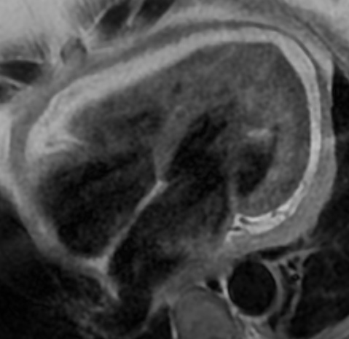
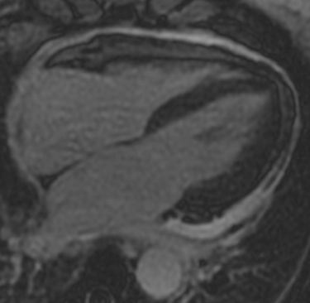
RESLUTS
Pericardial effusion (n=11) with pericardial thickening (n=3) were noticed.

Slide 7
RESLUTS
Non ischemic myocardial LGE was found in 4 patients, with typical features of amyloidosis in one.

Slide 8
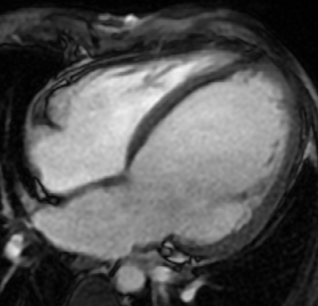
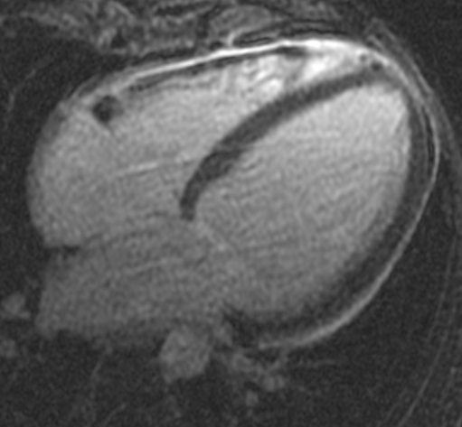
RESLUTS
The final diagnosis was CCP in 2 patients, RCM in 6 patients, a mixed CCP with RCM in 2 patients. In 5 patients, neither CCP nor RCM was retained and in one patient CMR was inconclusive but rather more in favor of the diagnosis of CCP.

Slide 9
DISCUSSION
DEFINITIONS:
CCP: diastolic dysfunction due to loss of percardial compliance.
RCM: diastolic dysfunction due to loss of diastolic volume of one or both ventricle associated with preserved systolic function.

Slide 10
DISCUSSION
Diagnostic problems:
Clinical feartues: both diseases have non specific clinical presentation. At an advanced stage, clinical features of global heart failure are found, except ventricular dilatation.
Echocardiography and cardiac catheterization: findings in both diseases may be similar in all respects.
Some features may be discriminatif unless their poor sensibilityand specificity.

Slide 11
DISCUSSION
Prognosis
Whatever the cause of RCM, the prognosis is always very bad with frequent early mortality, mainly in pediatric population.
In adults, except cardiac amyloidosis, one-year survival is almost zero.
It is madatory to differenciate RCM from CCP, the latter being accessible to surgical treatment.
Actually, CCP is often of good prognosis if surgical pericardectomy is performed in early stage.

Slide 12
DISCUSSION
CMR
CMR findings may be divided into:
Morphologic anomalies:
Pericardial thickening, enhancement and calcifications (CCP)
Myocardial hypertrophy, myocardial LGE (RCM)
Functional anomalies:
Diastolic dysfunction (CCP/RCM)
Respiratory variation of RV filling (CCP)

Slide 13
CMR: CCP versus RCM
 | CCP | RCM
Pericardial thickening | ++ | -
Septal kinetic anomalies | ++ | +
Ventricular interdependance, inspiratory accentuation | ++ | ++
Auricular dilatation | +ou - | +++
Ventricular hypertrophy | - | +
Ventricular volume | N | ⬇ N ⬆
LV systolic function | N | N ou diminué
LGE | pericardial | myocardial
All these findings have incomplete sensitivity and specificity for CCP versus RCM Considered separately, they have no diagnostic value.
The association of several or all findings may be diagnostic.

Slide 14
CONCLUSION
Differential diagnosis of CCP versus RCM is one of the most complicated diagnostic problems in cardiology practice.
Clinical features, ultrasonography and hemodynamic findings, are non specific.
MRI can provide arguments in favor of a diagnosis and sometimes even completely redirect the diagnostic suspicion thanks to its ability to explore the heart muscle and its enhancement.

